Slide 1

PRE-PROJECT PRESENTATION
SOLAR RADIATION PREDICTION
SUPERVISOR: DR. Hailiya Ahsan(Assistant Professor)
CO-SUPERVISOR: DR. Shoeb Hussain(Assistant Professor)
PRESENTED BY: Dhruv Sharma (2020BELE024)
Anurudra Yadav (2020BELE077)
Kaushinder (2020BELE099)

Slide 2
CONTENTS
INTRODUCTION
IMPORTANCE OF SOLAR RADIATION PREDICTION
CURRENT METHODS AND CHALLENGES
OUR APPROACH
DATA COLLECTION
TECHNICAL APPROACH
RESULTS
INFERENCES
APPLICATIONS OF SOLAR RADIATION PREDICTION
FUTURE OF SOLAR RADIATION PREDICTION
CONCLUSION

Slide 3
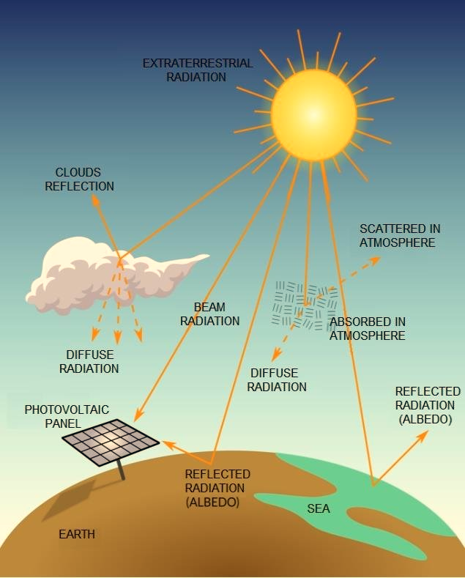
INTRODUCTION
Solar radiation plays a crucial role in various aspects of our lives, from powering renewable energy systems to influencing agricultural productivity and climate patterns.
However, accurately predicting solar radiation levels is challenging due to the complex interplay of weather conditions, geographical factors, and atmospheric dynamics.
In this project, we aim to develop a model that can predict solar radiation levels with high accuracy.
we hope to contribute to the advancement of renewable energy technologies and enhance our understanding of Earth's energy balance."

Slide 4
IMPORTANCE OF SOLAR RADIATION PREDICTION
01
Optimizing energy prediction
02
GRID MANAGEMENT
* grid operators to manage the integration of solar energy into the grid. Accurate predictions enable them to balance supply and demand, reduce the need for backup power sources, and prevent grid instability.
* Solar radiation prediction helps solar power plants optimize their energy production by anticipating fluctuations in sunlight.
Urban Planning and Agriculture
03
Cost Reduction
04
* predicting solar radiation more accurately, energy producers can reduce costs associated with inefficient energy production and grid management.
* It can help optimize the design of buildings for energy efficiency, as well as assist farmers in planning crop planting and harvesting times based on sunlight availability

Slide 5
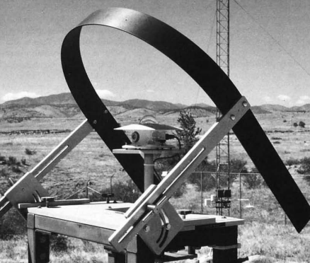
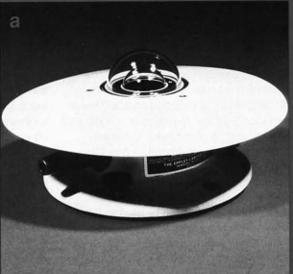
CURRENT METHODS AND CHALLENGES
Solar radiation prediction methods include:
Satellite data,
Ground-based sensors,
Numerical models.
Challenges:
due to cloud cover variability,
atmospheric complexity
data accuracy issues.

Slide 6

OUR APPROACH
We collect various datasets, including historical solar radiation data, satellite imagery, weather data, and atmospheric conditions, and preprocess them to ensure quality and standardization.
We then select the most relevant variables for predicting solar radiation levels using feature selection techniques.
We carefully choose machine learning algorithms and train them using cross-validation techniques.
We evaluate the trained models using validation data and deploy them for real-world use, continuously monitoring and updating them to ensure their effectiveness.

Slide 7
DATA COLLECTION
01
SATELLITE IMAGERY
02
WHEATHER DATA
real-time weather data from ground-based weather stations to supplement satellite data. This includes information on temperature, humidity, wind speed, and precipitation
We use high-resolution satellite imagery to capture spatial patterns of cloud cover, atmospheric conditions, and surface characteristics.
03
SOLAR-RADIATION DATA
04
ATMOSPHERIC CONDITIONS
Historical solar radiation data is essential for training our models and validating their performance. We gather this data from reliable sources to ensure accuracy and consistency
Data on atmospheric conditions, such as air pressure, moisture content, and aerosol levels, are collected to improve the accuracy of our predictions

Slide 8
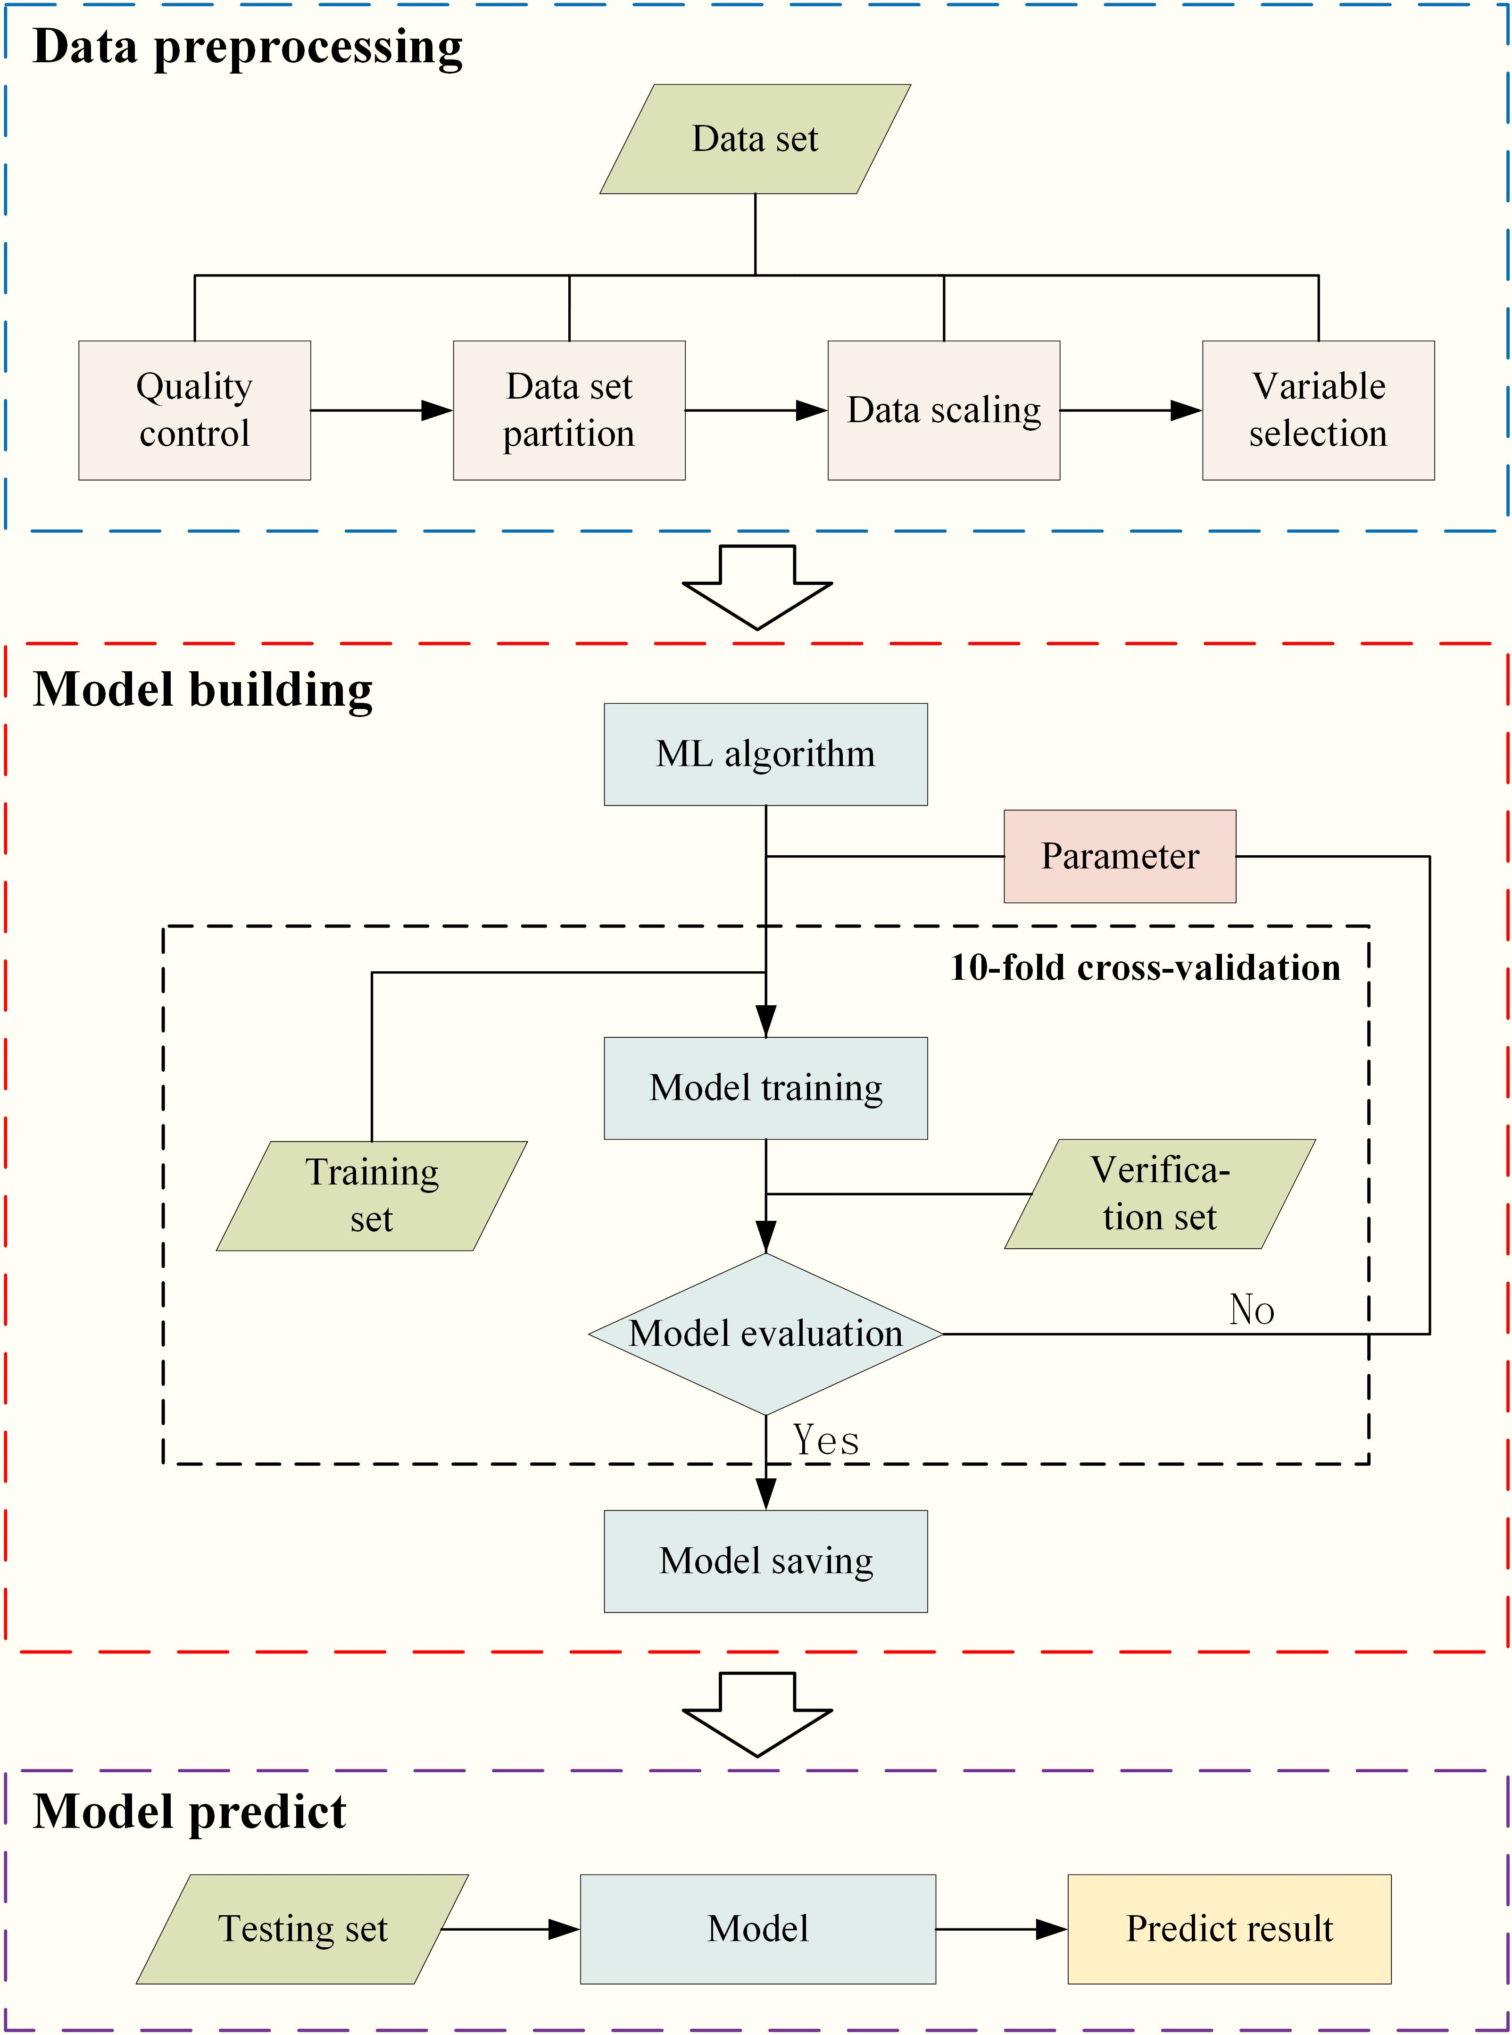
Technical Approach
● Solar radiation relies on weather patterns.
● The dataset has a total of 32,686 samples.
● 11 attributes are corresponding to each sample.
● Radiation is the response variable and the rest of the 10 attributes are the predictor variable.
● We plan to perform an 80-20 split to generate the train and test set.
-Standard models:
1. Linear Regression 2. SVR 3. MLP Regressor 4. Decision Tree Regressor 5. Gradient Boost 6. XGBoost 7. Random Forest

Slide 9
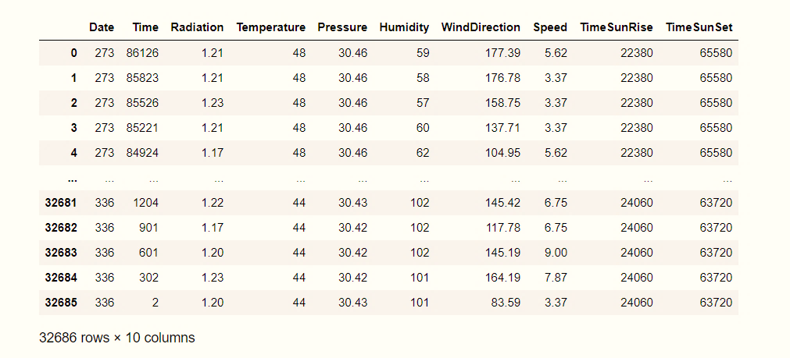
→Data preprocessing is crucial in data science to clean, transform, and prepare data for analysis. →It ensures data quality, improves model accuracy, and helps in extracting meaningful insights from the data. →A real world data generally contains noise, missing value and may be in unusable format. Fig: Solar Data Set after Pre Processing
DATA PROCESSING

Slide 10
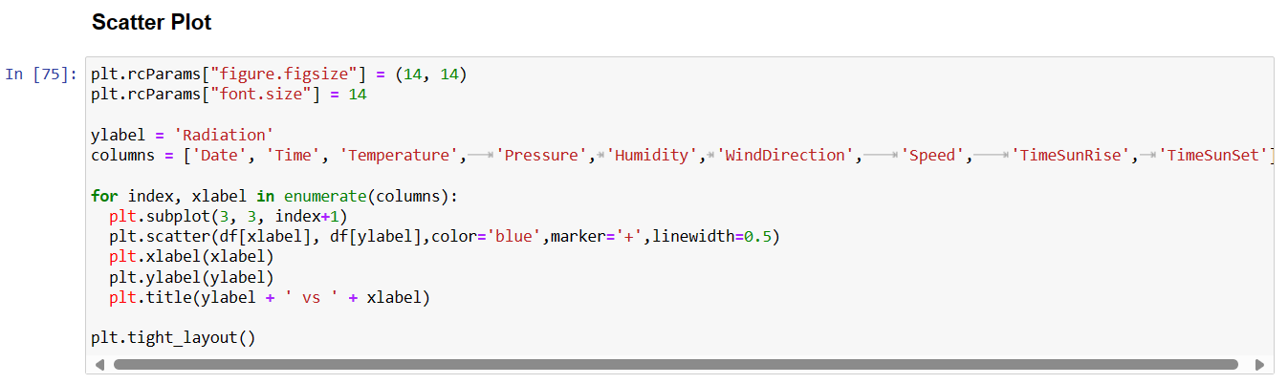
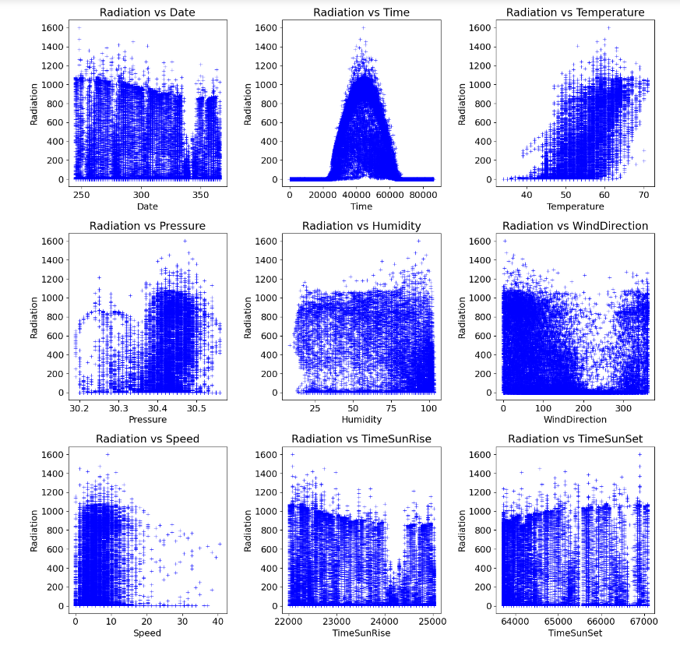
-high correlation between temperature, pressure, humidity, Wind Direction with radiation.
- plot indicates that radiation depends on the time of the day.
low →early morning,
maximum → noon, and
gradually decreases →end of the day.
Fig. Scatterplot of different features of dataset against Radiation

Slide 11
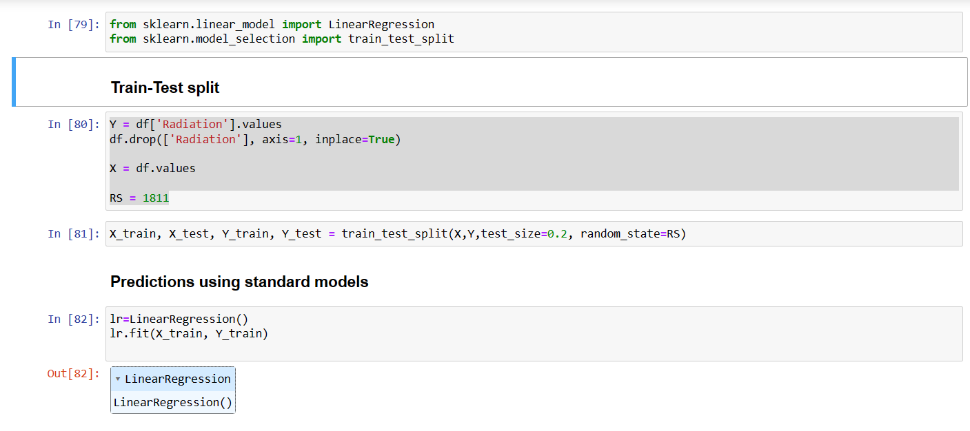
Results:
Linear Regression
Linear Regression fits a linear model with coefficients w = (w1, …, wp) to minimize the residual sum of squares between the observed targets in the dataset, and the targets predicted by the linear approximation.
R^2 is a number that explains the amount of variation/accuracy that is explained by the developed model.
It always ranges between 0 & 1.
Train: 0.6190414543792242 ≈ 62.04%
Test: 0.625918994079995 ≈ 62.6%
Multiple linear regression is a statistical method used to model the relationship between multiple independent variables and a dependent variable.
Independent var: Temp, speed. Pressure, humidity, wind direction etc.….
Dependent var: Radiation

Slide 12
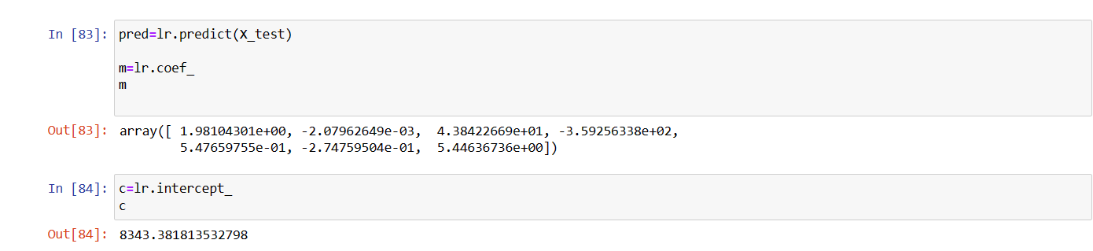
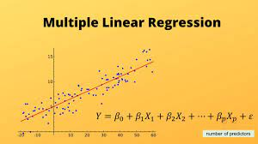
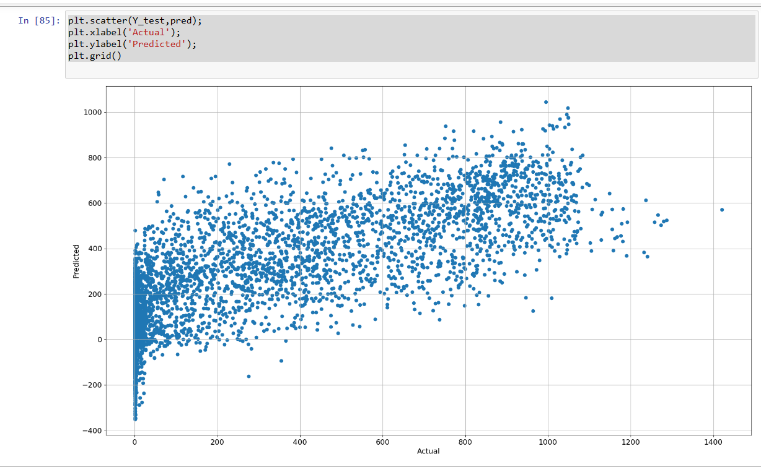
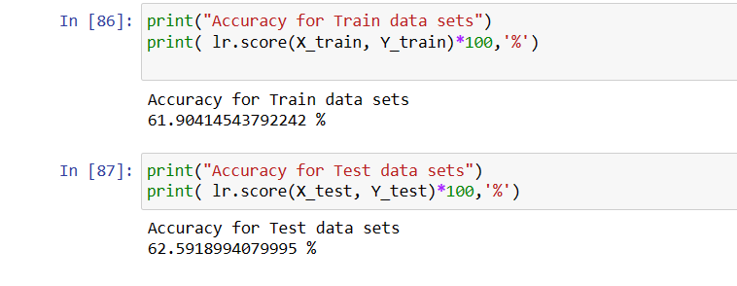
Results:

Slide 13
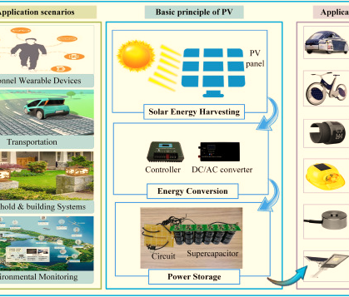
APPLICATIONS OF SOLAR RADIATION PREDICTION
Renewable Energy Planning: The accurate prediction can help solar power plants optimize their energy production and improve overall efficiency.
Grid Management: It enables grid to operates to better integrate solar energy into the grid, reduce reliance on fossil fuels, and improve grid stability.
Climate Research: Our model can contribute to climate research by providing valuable insights into solar variability and its impact on the Earth's climate system.
Agricultural Management: Farmers can use solar radiation predictions to optimize crop planting and harvesting times, leading to improved agricultural productivity.

Slide 14

FUTURE WORK OF SOLAR RADIATION PREDICTION
Enhanced Data Collection: Continuously improve our data collection methods to incorporate new sources of data and enhance the quality and reliability of our predictions.
Model Refinement: Refine our machine learning algorithms to improve prediction accuracy, particularly in challenging weather conditions.
Global Scalability: Further refine our model to make it more scalable and adaptable to different regions and climates around the world.
Integration with Energy Systems: Explore ways to integrate our solar radiation prediction model with energy systems to optimize energy production and consumption.

Slide 15
CONCLUSIONS
-A significant advancement in the field of renewable energy planning and grid management.
-By machine learning algorithms and high-resolution satellite data, we have developed a model that can accurately forecast solar radiation levels, even in complex weather conditions.
-This model has numerous practical applications, including optimizing energy production, improving grid stability, and advancing climate research.
-Through our project, we have demonstrated the potential of data-driven approaches to enhance the reliability and efficiency of solar energy systems.
However, there is still much work to be done to further refine our model and expand its capabilities.
-Future efforts will focus on enhancing data collection methods, refining machine learning algorithms, and integrating our model with energy systems to maximize its impact.

Slide 16
REFERENCES
1. K. Venu, K. V. Indhu Prakash, S. Jayaram, N. S. Karan, M. M. Raja and K. Renu, "Solar Radiation Prediction using Machine Learning Model," 2023 International Conference on Sustainable Computing and Data Communication Systems (ICSCDS), Erode, India, 2023, pp. 52-57, doi: 10.1109/ICSCDS56580.2023.10104904.
2. https://www.kaggle.com/datasets/anikannal/solar-power-generation-data
3. Solar irradiance forecasting models using machine learning techniques and digital twin: A case study with comparison. https://www.sciencedirect.com/science/article/pii/S2666603023000064
4. https://en.wikipedia.org/wiki/Solar_irradiance

Slide 17
THANK YOU!

